Slide 1


TransArt: A Multimodal Application for Vernacular Language Translation and Image Synthesis
by R. SURESH KUMAR

Slide 2
PROBLEM STATEMENT :
Develop a web-based application that translates Tamil text to English and uses the translation to generate relevant images and creative content, showcasing the integration of translation and generative AI.
OBJECTIVE
Deploy a multimodal AI application using Streamlit or Gradio on Hugging Face Spaces or AWS, enabling Tamil-to-English translation, text-to-image generation, and creative text generation

Slide 3
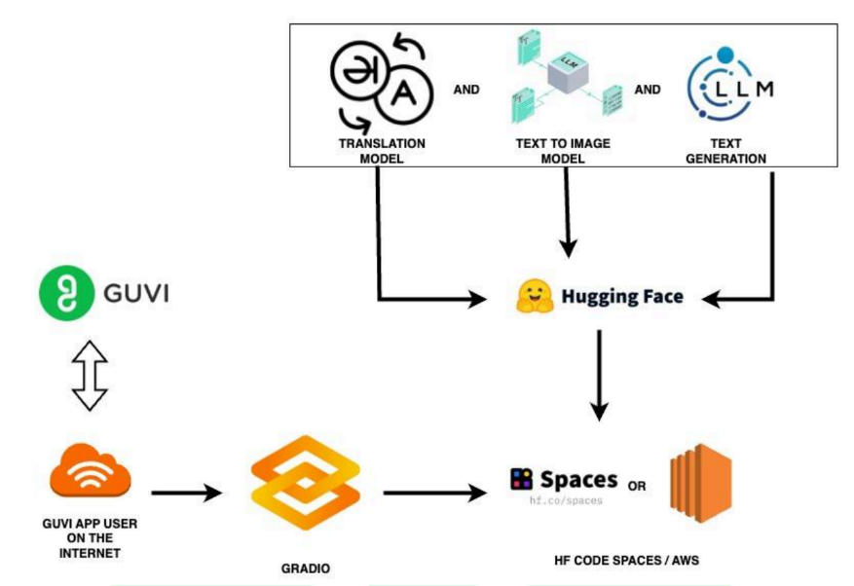
APPROACH :

Slide 4
USED MODELS :
TRANSLATION MODEL - facebook/mbart-large-50-many-to-many-mmt
Text to image generating model - stabilityai/stable-diffusion-2-1
Translated text to generate creative text – GPt2
1. TRANSLATION MODEL :
facebook/mbart-large-50-many-to-many-mmt is a multilingual neural machine translation (NMT) model developed by Facebook AI (now Meta AI).
It’s part of the mBART (Multilingual BART) family. It is designed for translation between 50 different languages, not just to or from English, but from any language to any other (many-to-many).

Slide 5
I am using the ROUGE L evaluation metric(Recall-Oriented Understudy for Gisting Evaluation). The ROUGE L score gives 0 to 1. ROUGE-L is an automatic evaluation metric for comparing the quality of generated text (e.g., translated output) against reference text (ground truth). It is especially effective at evaluating how well the sequence and structure of the generated text align with the reference.
It finds the Longest Common Subsequence (LCS) and then calculates the score
Precision = LCS length/length of generated sentence
Recall = LCS length/length of reference sentence
F1-score = Harmonic mean of precision and recall
2. TEXT TO IMAGE GENERATION MODEL :
The “openai/clip-vit-base-patch32” model is part of the Stable Diffusion family, developed by Stability AI, and it's designed to generate realistic or artistic images from natural language text prompts.

Slide 6
3. TEXT TO IMAGE GENERATION MODEL :
🧠 How it works:
Embeds both the English text and image.
Computes similarity between them using cosine similarity in embedding space.
Since you're using CLIP to compare a text prompt (English translation) with the generated image, your scores will usually fall between 0.2 to 0.9(Higher is better).
NOTE: This project is completely run using the CPU, so the scores give minimal values.
The GPT-2 to generate creative English text from the translated prompt. To evaluate how good or meaningful that generated text is, you include some metrics to measure quality, diversity, and fluency, even though creativity is hard to measure objectively.

Slide 7
🧠 How GPT-2 (Generative Pre-trained Transformer 2)works:
You give it an input prompt (like English text).
GPT-2 generates a continuation based on what it learned during pretraining.
The longer and more context-rich the prompt, the more relevant the generation.
1. 🔁 Repetition Rate (Promote diversity ):
What it checks: How often the same word is repeated back-to-back.
Why it matters: High repetition = less creativity and poor model behavior.
Ideal: Should be low (< 0.2) for creative, diverse text.
2. 📉 Perplexity (Ensure fluency):
What it means: Measures how surprised the model is by its own output.
Formula: Perplexity=eloss\text{Perplexity} = e^{\text{loss}}Perplexity=eloss
Lower is better:
< 20–30 = usually fluent and coherent text.
50–100+ = awkward or unnatural text.
✅ GPT-2 is evaluated internally by computing loss on its generated output and transforming it into perplexity.

Slide 8
REFERANCE INPUT TEXT :
3. 🔢 Token Count (Ensure sufficient length ): What it tells you: Number of words/tokens in the generated text. Why it's useful: Helps check that the output isn't too short or too long. < 10 → too short 10–50 → good range for creative output
சூரிய உதயம் கிழக்கில் தோன்றுகிறது.
The sunrise appears in the east.
MODEL OUTPUT :
This model gives translated word - The sun rises in the east.
Rouge L – 0.6667
Clip text – image similarity – 0.2537
Token is – 84
Repetition rate – 0.0
Perplexity - 10.9028

Slide 9
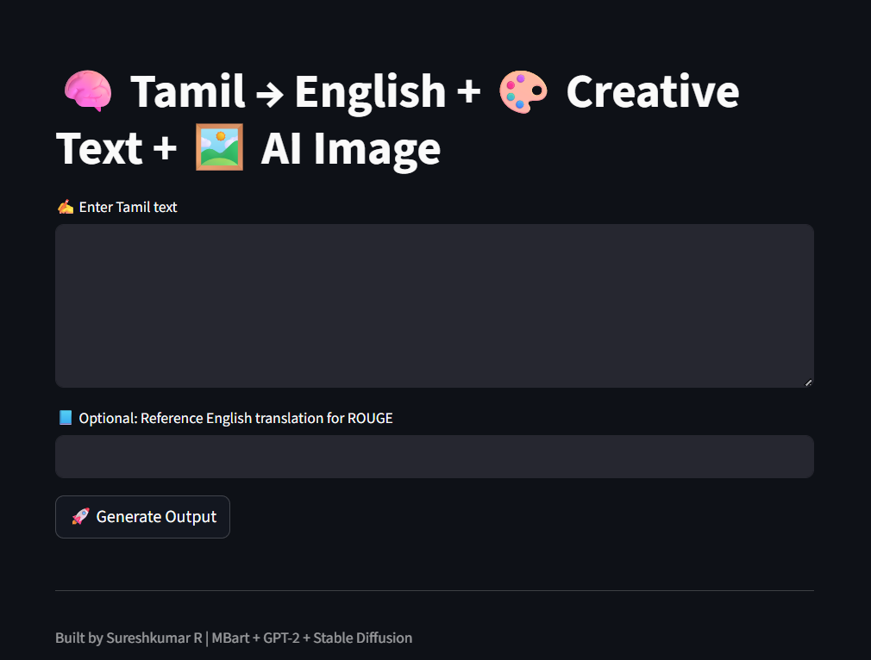

STREAMLIT APP
Finally build user friendly STREAMLIT app that translate Tamil → English then Generate image → finally Creative text based on Translated English.
The input method in Tamil language.
Another input is calculating ROUGE L score. The ROUGE L score calculate similarity between actual English word and Translated English word.
HUGGING FACE APP : Tamil to Image Generator - a Hugging Face Space by 24Sureshkumar

Slide 10
THANK YOU

